Slide 1
Crowdsourced App for Patient Support
(CAPS)
Team #27
Frank Klucznik: frank.klucznik@gtri.gatech.edu
Joseph Freivald: jfreivald@gatech.edu
Kevin Schildhorn: schilk@gatech.edu
Ryan Linnane: rlinnan3@gatech.edu

Slide 2
Content
Overview
Architecture
CAPS Management Portal Requirements
Patient App Requirements
Support Group App Requirements
Use Case Diagrams
Database (i.e., requirements, design)
Data Exchange Requirements
UI Design (i.e., management portal, patient app, support team app)

Slide 3
Overview – CAPS
PATIENT FACING TOOLS:
Establish and provision a virtual team for supporting an individual requiring long term medical care (i.e., cancer, rehab individual, war veteran, chronic illness, etc.)
Features include mobile device supported web service, patient data retrieved from FHIR
Functions include:
Reminder to take some action (i.e., medication, eat, exercise, etc.)
Appointment logistics and reminders (i.e., who is providing transport, pick up time, etc.)
Status queries
Help request
Additional features: Emergency Contact / 911 notifications, no response alerts, etc.
Registration, setup and configuration management accomplished via website.

Slide 4






Architecture Overview
Support Group
Patient
API
API
CAPS
Management
Portal
Software
FHIR
Web Host
HIPPA Compliant Database
CAPS Server

Slide 5
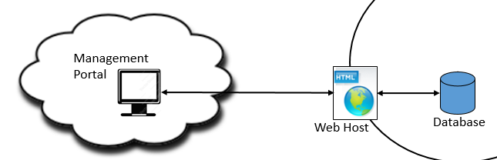
CAPS Management Portal Requirements
Setup and Configuration Management
Enter Patient Information
Name
Method of contact (i.e., email, text, etc.)
Details (i.e., phone #, email address, etc.)
Enter Support Group Member Information
Name
Method of contact (i.e., email, text, etc.)
Details (i.e., phone #, email address, etc.)
Enter Emergency Contact Information
Name
Method of contact (i.e., email, text, etc.)
Details (i.e., phone #, email address, etc.)
Enter Event Information
Reminder (to take some action)
Reminder (medical appointment)
Functionality - for details refer to follow on use case diagrams
Query FHIR database
Retrieve FHIR data for patient
Patient Alerts
Medical Appointment
Status Check
Help Request

Slide 6

Patient App Requirements
Ack / Confirm action taken (mandatory)
Send current status (mandatory)
Add text note (optional)
Send HELP request (optional)

Slide 7
Support Team App Requirements
Ack / Confirm help request (optional)
Query current status (optional)
Ack / Confirm medical appointment reminder
Add text note (mandatory for medical appointment reminder)

Slide 8
Use Case 1: Management Portal Scenario 1: Create Account (user/pwd)
NOTE: Joe – need your input on these UIs
Username
Password
Login
Register

Slide 9

Use Case 1: Management Portal Scenario 2: FHIR Data Retrieval
Support Group
FHIR
CAPS
Server
1
Support group admin
Queries FHIR to download patient data
Request for patient data
2
Patient data
#
- Reference ID for UI on next slide

Slide 10
Use Case 1: Management Portal Scenario 2: FHIR Data Retrieval
NOTE: Joe – need your input on these UIs
1
2
FHIR Patient Search
FHIR Data
Send
Cancel

Slide 11
Use Case 1: Management Portal Scenario 3: Basic Configuration
NOTE: Joe – need your input on these UIs
Patient
Contact
Event
Day/Time
Notes
Support Team

Slide 12
Use Case 2: Patient Alert – Scenario 1
Support Group
Patient
CAPS
Server
1
CAPS notification to take some action (i.e., eat, medication, etc.)
Patient confirms action taken
and conveys status
2
3
Support group notified action taken & status
If status yellow or red support group initiate direct contact w/ patient
#
- Reference ID for UI on next slide

Slide 13


Use Case 2: Patient Alert – Scenario 1
Patient UI
1
Patient UI
Support Team UI
2
3
MEDICATION
REMINDER
Take 1 500mg tablet of aspirin
Take with food
Text Message Response Here
NOTICE
David took his 1 tablet of 500 mg of aspirin
Click Emoji to Send
Acknowledge
Close

Slide 14
Use Case 2: Patient Alert – Scenario 2
Support Group
Patient
CAPS
Server
1
CAPS notification to take some action (i.e., eat, medication, etc.)
30 min
Timer
Support group alerted no response from patient
2
Support Group Ack
Support group initiate direct contact w/ patient
#
- Referrence ID for UI on next slide

Slide 15

Use Case 2: Patient Alert – Scenario 2
Patient UI
1
Support Team UI
2
MEDICATION
REMINDER
Take 1 500mg tablet of aspirin
Take with food
ALERT
David did not respond to his medication reminder
Acknowledge
Acknowledge

Slide 16
Use Case 3: Medical Appointment – Scenario 1
Support Group
Patient
1
CAPS
Server
Support group notified of upcoming medical appointment
2
Support group provides transportation details
CAPS medical appointment reminder w/ transport details
3
Patient confirms receipt &
conveys status
4
Support group receives confirmation & status
#
- Reference ID for UI on next slide

Slide 17
Use Case 3: Medical Appointment – Scenario 1
Support Team UI
Support Team UI
Patient UI
Support Team UI
1
2
3
4
REMINDER
Appointment
Jane will pick you up at 0930 tomorrow to take you to your appointment at the Marshfield Clinic.
NOTICE
David acknowledged his appointment for tomorrow.
REMINDER
David has a follow up doctor appointment tomorrow at 10 am at the Marshfield Clinic. He requires transportation.
Text reply message here describing transportation for David’s appointment tomorrow
Acknowledge
Acknowledge
Send
Close

Slide 18
Use Case 3: Medical Appointment – Scenario 2
Support Group
Patient
1
CAPS
Server
Support group notified of upcoming medical appointment
2
Support group provides transportation details
CAPS medical appointment reminder w/ transport details
3
30 min
Timer
Support group alerted no response from patient
4
Support Group Ack
Support group initiate direct contact w/ patient

Slide 19
Use Case 3: Medical Appointment – Scenario 2
Support Team UI
Support Team UI
Patient UI
Support Team UI
1
2
3
4
REMINDER
David has a follow up doctor appointment tomorrow at 10 am at the Marshfield Clinic. He requires transportation.
Text reply message here describing transportation for David’s appointment tomorrow
REMINDER
Appointment
Jane will pick you up at 0930 tomorrow to take you to your appointment at the Marshfield Clinic.
ALERT
David did not respond to his appointment reminder
Acknowledge
Acknowledge
Send
Acknowledge

Slide 20
Use Case 4: Status Check – Scenario 1
Support Group
Patient
1
Support group member initiates
status check from patient
CAPS
Server
2
CAPS status check query
3
Patient conveys status
4
Support group notified of status
If status yellow or red support group initiate direct contact w/ patient

Slide 21

Use Case 4: Status Check – Scenario 1
Support Team UI
Patient UI
Patient UI
Support Team UI
1
2
3
4
Status Check
How are your feeling?
Text Message Response Here
NOTICE
I am feeling very well thank you.
Send Status Request
Click Emoji to Send
Acknowledge
Close

Slide 22
Use Case 4: Status Check – Scenario 2
Support Group
Patient
1
Support group member initiates
status check from patient
CAPS
Server
2
CAPS status check query
30 min
Timer
Support group alerted no response from patient
3
Support Group Ack
Support group initiate direct contact w/ patient

Slide 23
Use Case 4: Status Check – Scenario 2
Support Team UI
Patient UI
Support Team UI
1
1
3
Status Check
How are your feeling?
ALERT
David did not respond to his Status Check
Send Status Request
Acknowledge
Acknowledge

Slide 24
Use Case 5: Patient Help Request – Scenario 1
Support Group
Patient
CAPS
Server
1
Patient requests help
Support group notified
2
Support Group Ack
Support group initiate direct contact w/ patient

Slide 25
Use Case 5: Patient Help Request – Scenario 1
Patient UI
Support Team UI
1
2
SEND HELP REQUEST
ALERT
David requires your immediate assistance
Acknowledge

Slide 26

Use Case 5: Patient Help Request – Scenario 2
Support Group
Patient
CAPS
Server
1
Patient requests help
Support group notified
30 min
Timer
CAPS notifies emergency
contact and 911

Slide 27
Use Case 5: Patient Help Request – Scenario 2
Patient UI
Support Team UI
1
2
SEND HELP REQUEST
ALERT
David requires your immediate assistance
Acknowledge

Slide 28
Use Case 6: Login to CAPS
Support Group
Patient
CAPS
Server
1
Patient Logs In
1
Support Group Logs In
2
2
Patient Ack
Support Group Ack

Slide 29

Use Case 6: Login to CAPS
Username
Welcome to CAPS. You are all set!
Password
Login Screen
Acknowledge

Slide 30
Support Team Data Requirements
Support Team Data
Id (unique identifier)
name (Fname, Lname)
role (i.e., support, patient, caregiver, emergency contact)
contact_method (i.e., email, text, phone call)
email_address
phone_provider (if text only; , , , , , , , , , )
phone_number (U.S. only for now, add country code in the future)

Slide 31
Activity Data Requirements
Activity Data
Id (unique record identifier)
patient_id (link to profile table)
action (i.e., take medication, eat, sleep, bathe, check BP, check blood sugar,
status check, help request, etc.)
sent_date_time (time reminder was sent/received at CAPS; start 30 min countdown)
ack_date_time (time reminder was confirmed by patient or support group)
ack_id (id of person who sent confirmation)
patient_status ( )
failure_date_time (time failure to ack was noted)
failure_notice_date_time (time failure notice was sent to support group)

Slide 32
Schedule Data Requirements
Reminder Schedule
Id (unique record identifier)
patient_id (link to profile table)
action (i.e., take medication, eat, sleep, bathe, check BP, check blood sugar,
status check, help request, doctor appointment, etc.)
reminder_date_time (for reminder to be sent)
note (text field to include in reminder)

Slide 33
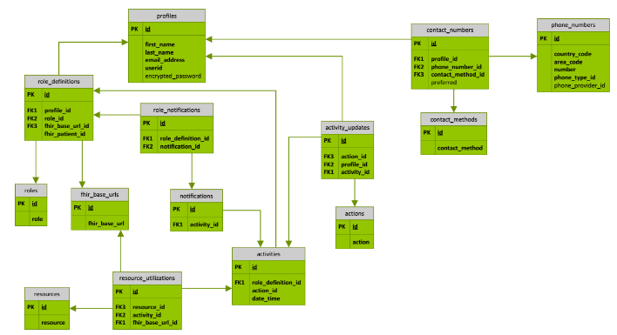
Database Design

Slide 34
Data Exchange Requirements
Data Exchange between CAPS and patient / providers
Id (from activity table)
patient_id (link to profile table)
recipiant_id (ID of who the message is being sent to)
action (i.e., take medication, eat, sleep, bathe, check BP, check blood sugar,
status check, help request, doctor appointment, etc.)
note (text field to include in reminder)
patient_status (may be blank)
message_type (i.e., ack, status check, help)

